Slide 1
Git and GitHub
Atul Kahate

Slide 2
Version Control Systems
Why do we need version control systems/software?
Many developers, a single (integrated) code, configuration files, database scripts, etc
Simultaneous changes done for bug fixing
Local copies maintained by each developer
Overwriting each other’s changes
Unauthorized changes to the code
Maintaining different code bases
Need for reverting to an older version of the software
Imagine that there are two developers who are developing code on an application server

Slide 3
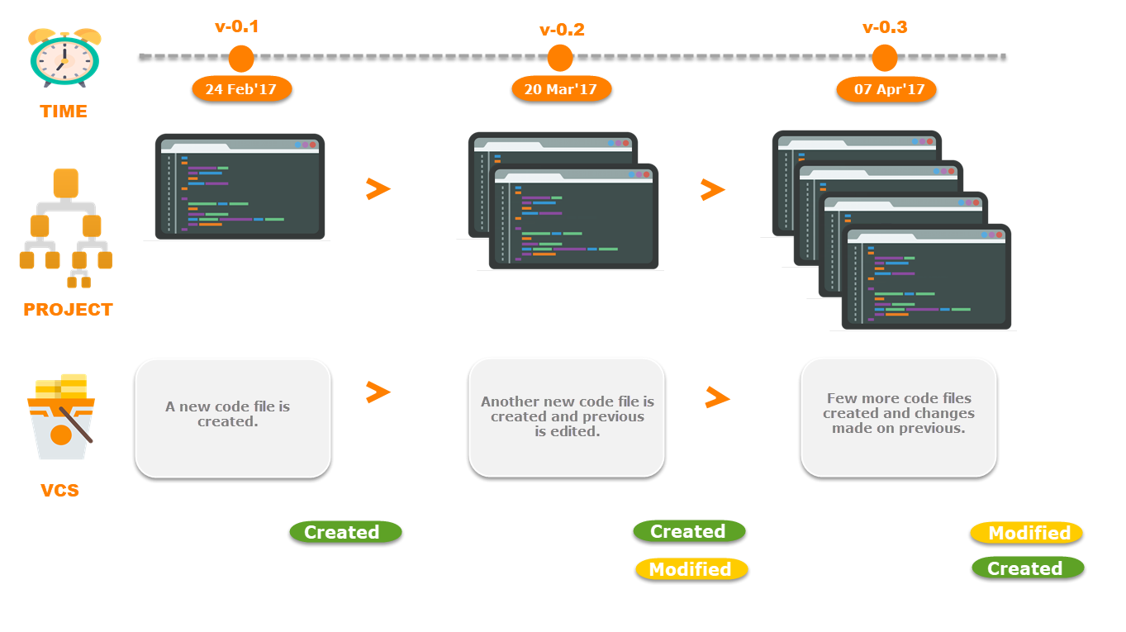
Git – A Version Control System

Slide 4
Different Developers Working on the Same Code on their Local Copies
Developer 1
…
…
…
Developer 2
…
…
…
Whose code should be considered as final?

Slide 5
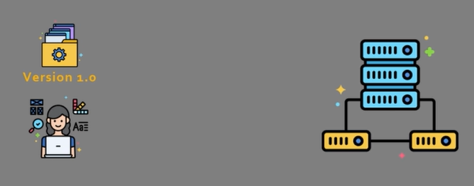
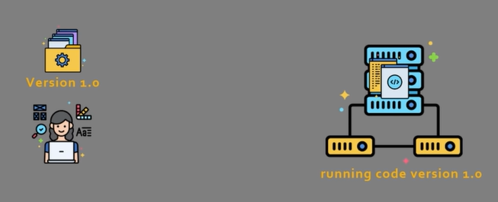
Version control example
Developer 1 wants to push version 1.0 of the code to an application server
After the push, the server runs code version 1.0

Slide 6
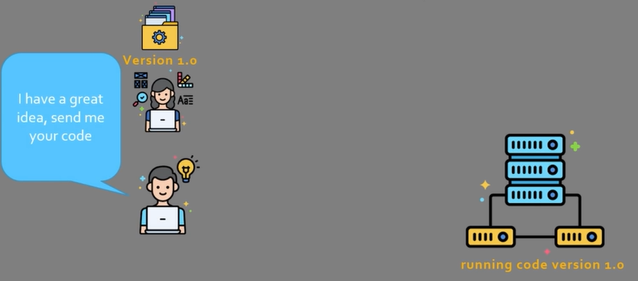
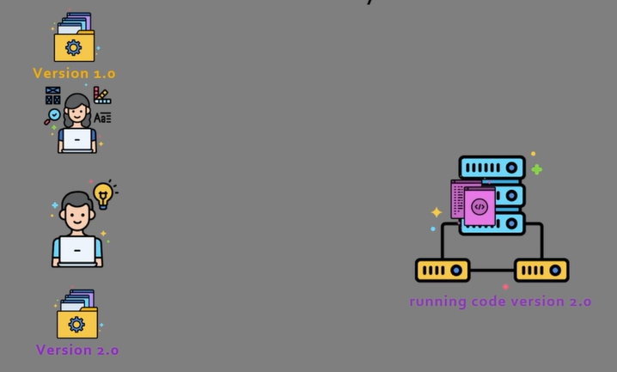
Version control example
Now a team member asks for her code
This team member has a folder called Version 2.0 and has deployed this version of the code on the server

Slide 7
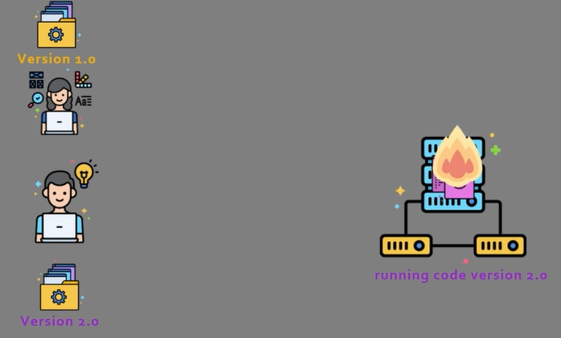
Version control example
Unfortunately, his code was not properly tested, and hence, crashes
Rolling back to version 1.0 is not easy – it is all mixed up

Slide 8
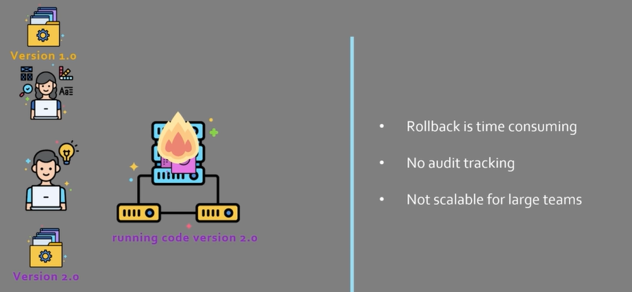
Problem summary

Slide 9
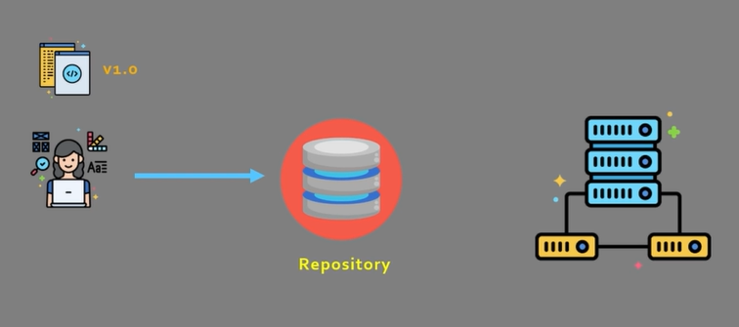
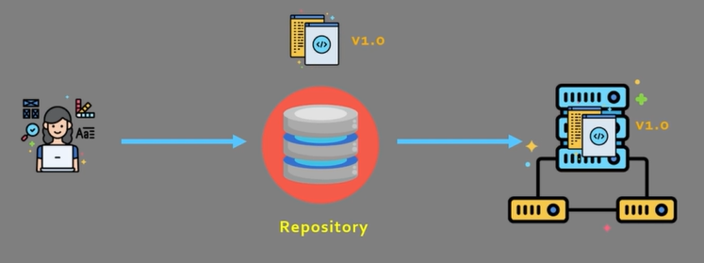
Version Control System and Repository
Developers now push the code to a repository
Code will be deployed from the repository

Slide 10
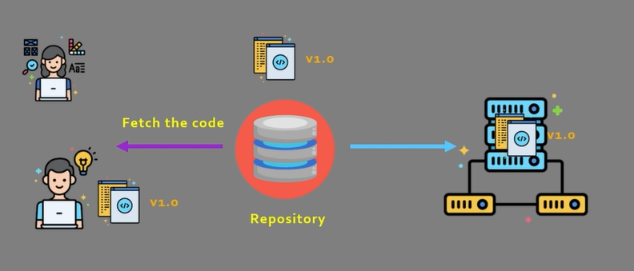
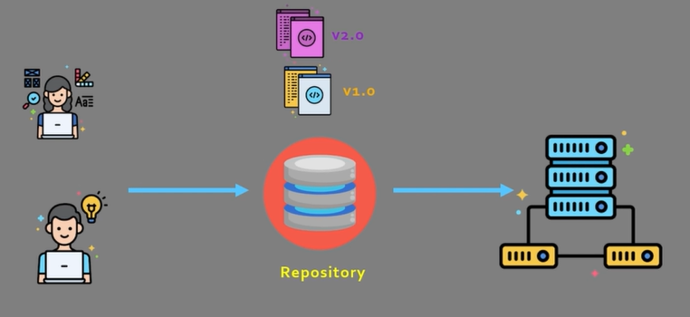
If another team member wants the code …
Fetch
Modify and push

Slide 11
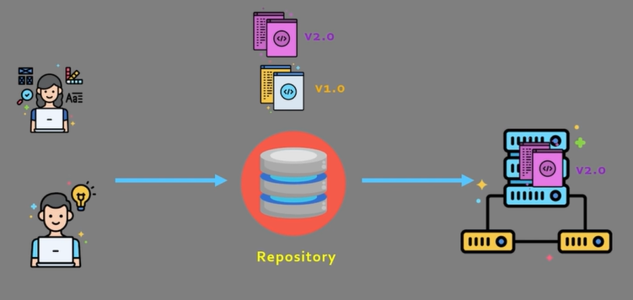
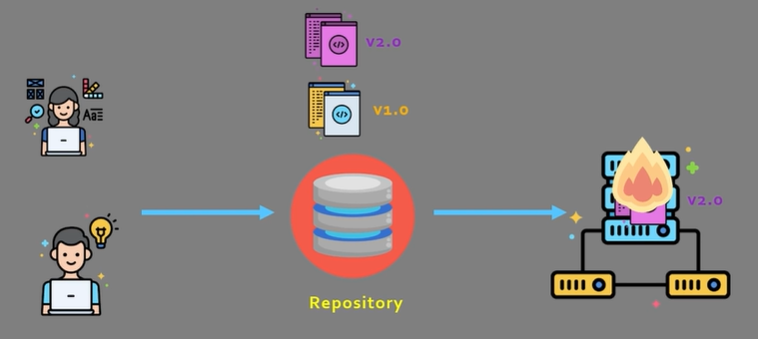
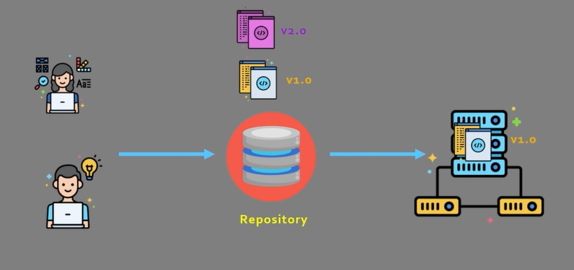
Deploy the new version
Deployed
Problems? Go back to version 1

Slide 12
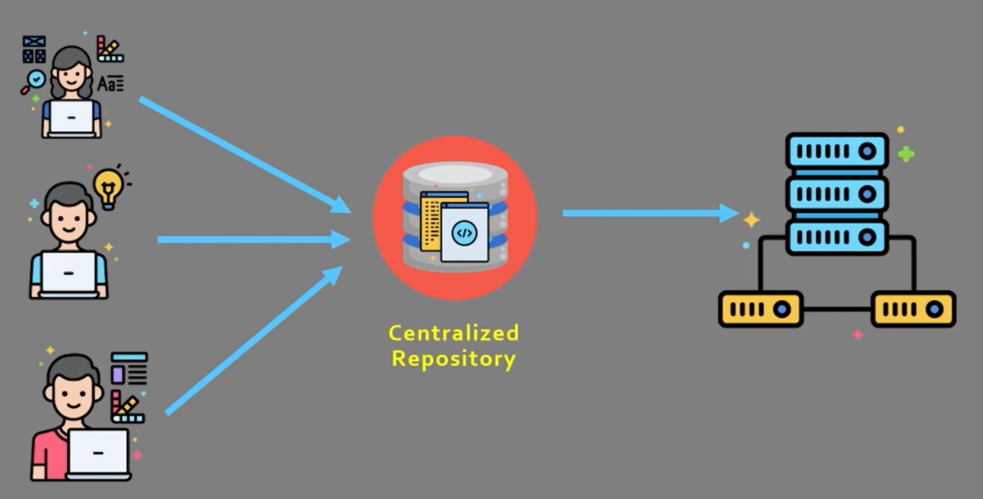
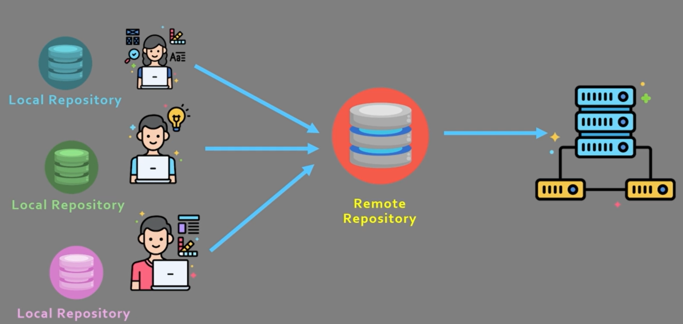
Types of Version Control System
Centralized
Each user has a local copy, but there is one central repository
Single point of failure
Requires constant connectivity
e.g. Subversion, Endevor
Distributed
Distributed
Each developer has a local copy and a separate repository, so loss of connection is manageable
More scalable
e.g. Mercurial, Git

Slide 13
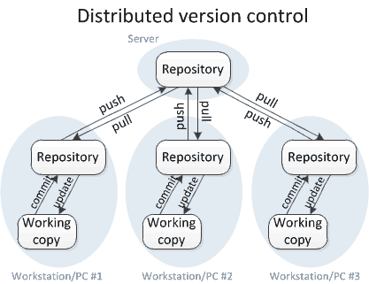
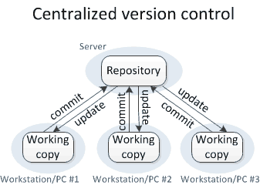
Centralized versus Distributed Version Control
For others to see your changes, 2 things must happen:
You commit
They update
For others to see your changes, 4 things must happen:
You commit and push
They pull and update

Slide 14
Commands and their Meaning
Commit and update commands: Only move changes between the working copy and the local repository, without affecting any other repository.
Push and pull commands: Move changes between the local repository and the central repository, without affecting your working copy.

Slide 15
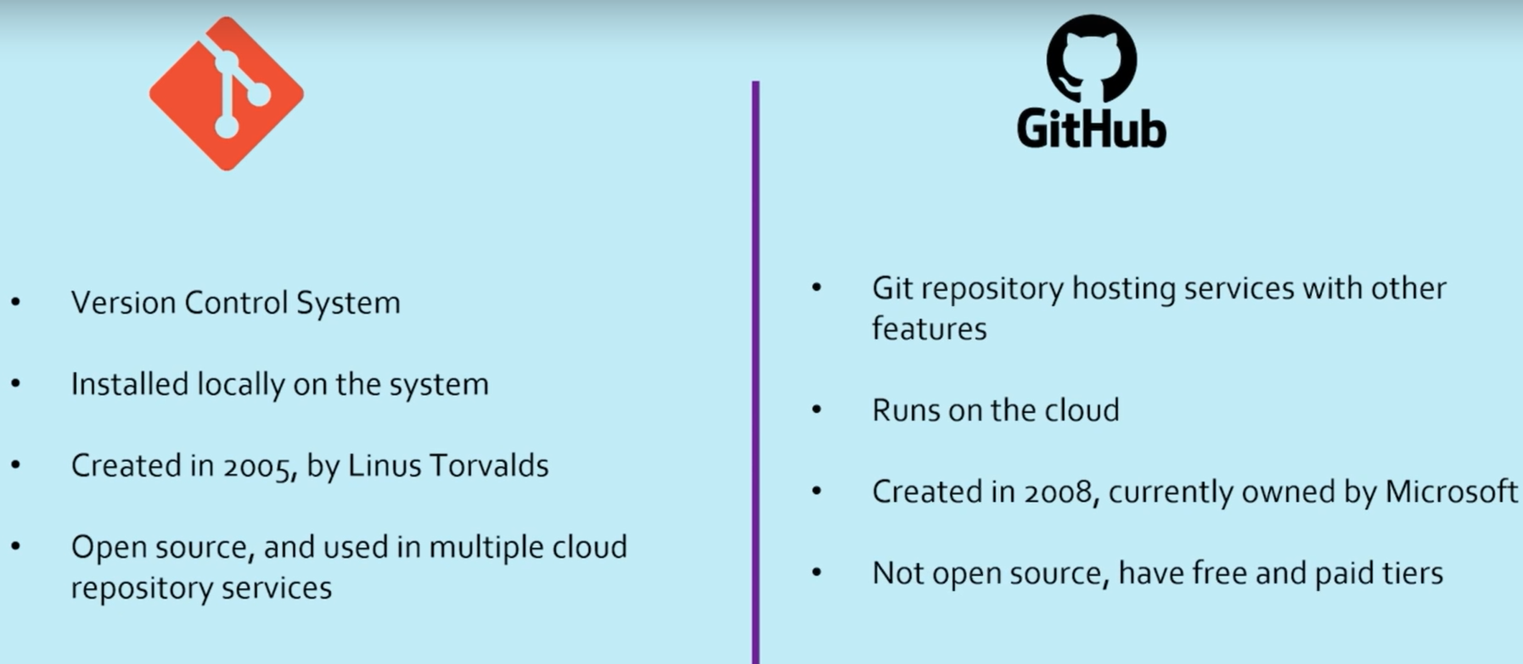
Git is not GitHub
Git

Slide 16
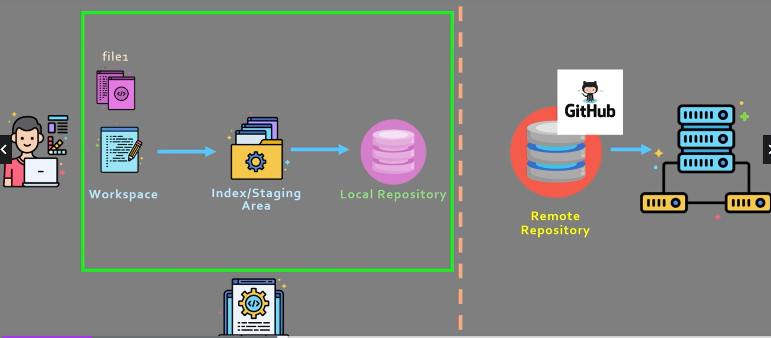
Git Workflow – 1

Slide 17
Git Workflow – 2
There are 3 distinct parts
Workspace – Area where the user is working and creating/modifying code
Index/Staging area – Area that closely mimics the local repository
Local repository – The local area for all the code
How this works? – Next slide

Slide 18
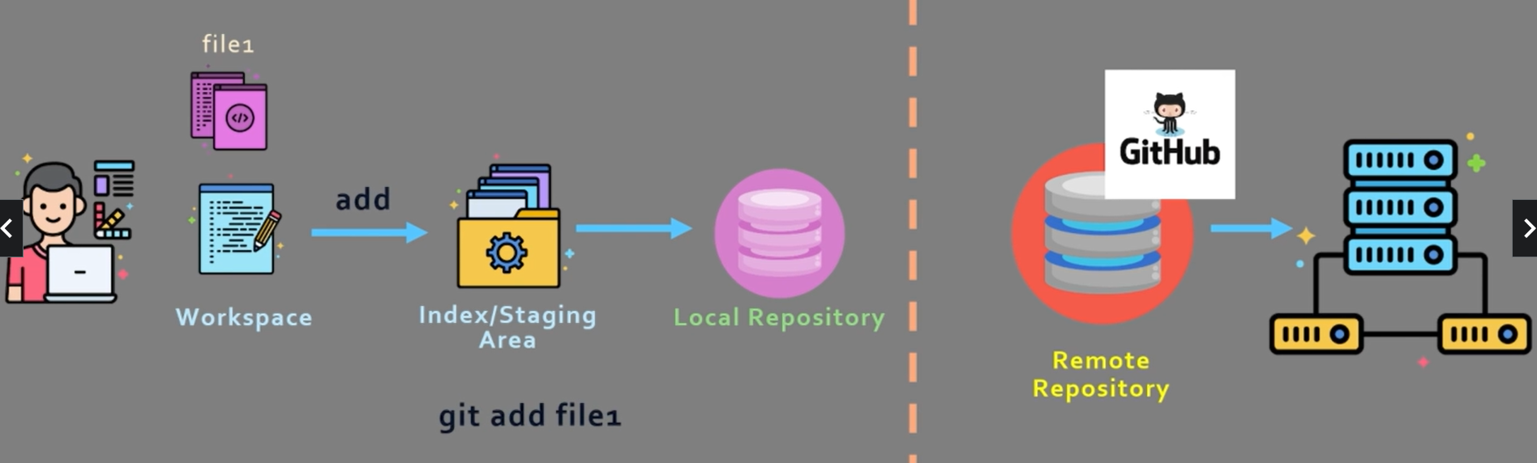
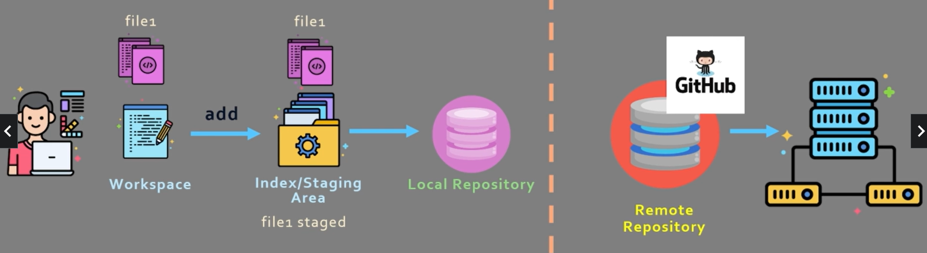
Git Workflow – 3
When user says git add file1, it will get added to the staging area

Slide 19
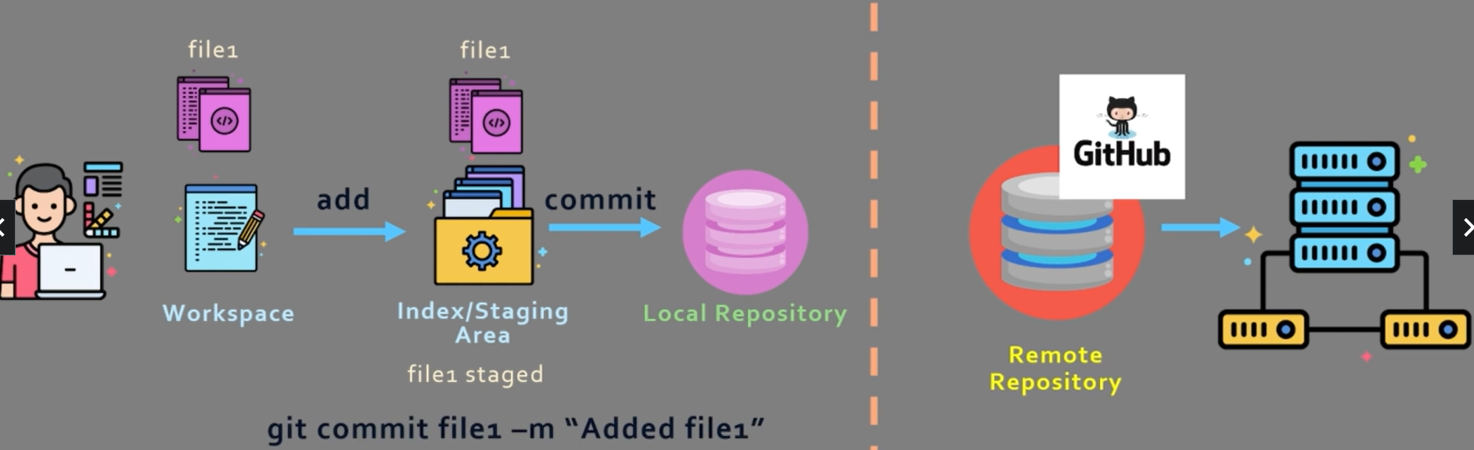
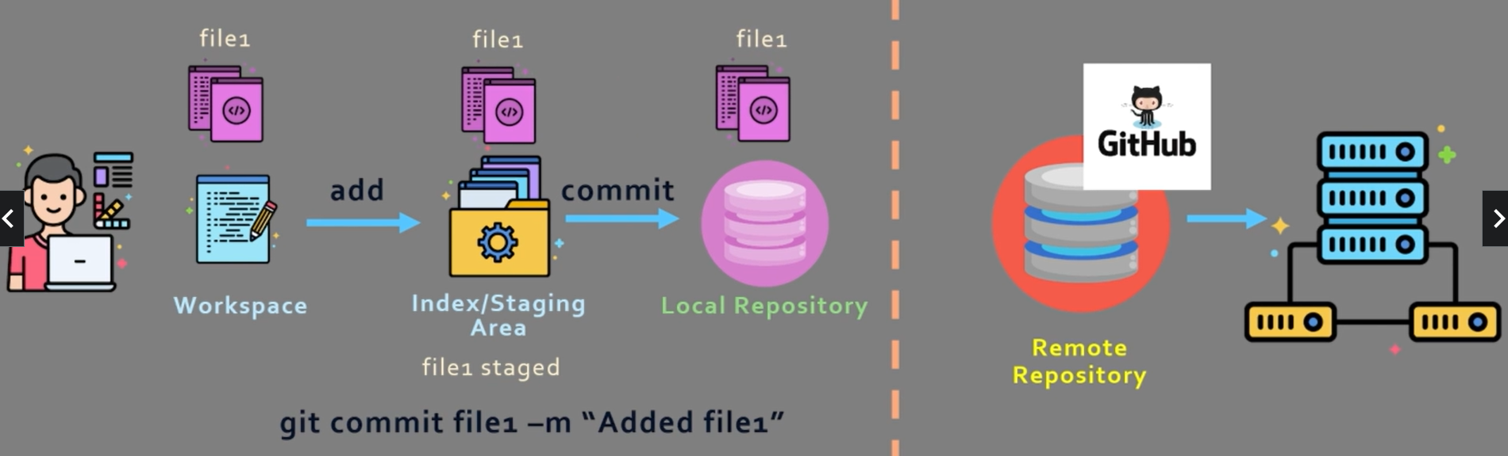
Git Workflow – 4
When user says git commit file1 –m “Added file1”, it will get added to the local repository

Slide 20
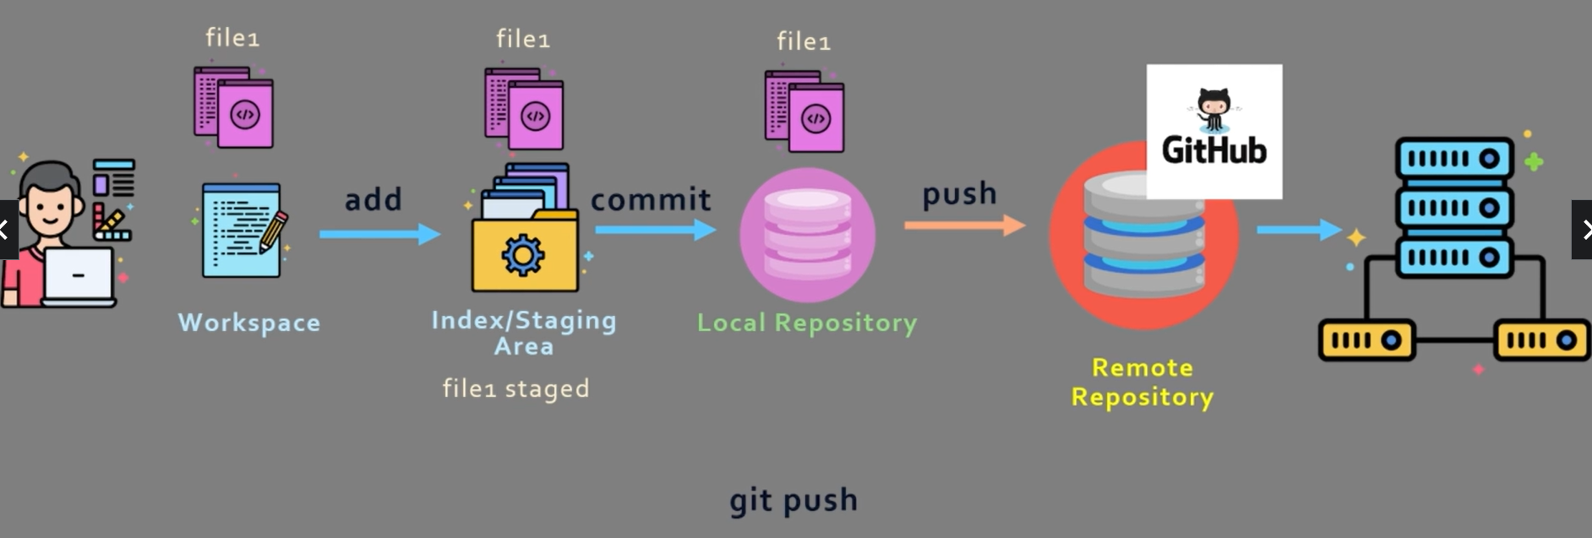
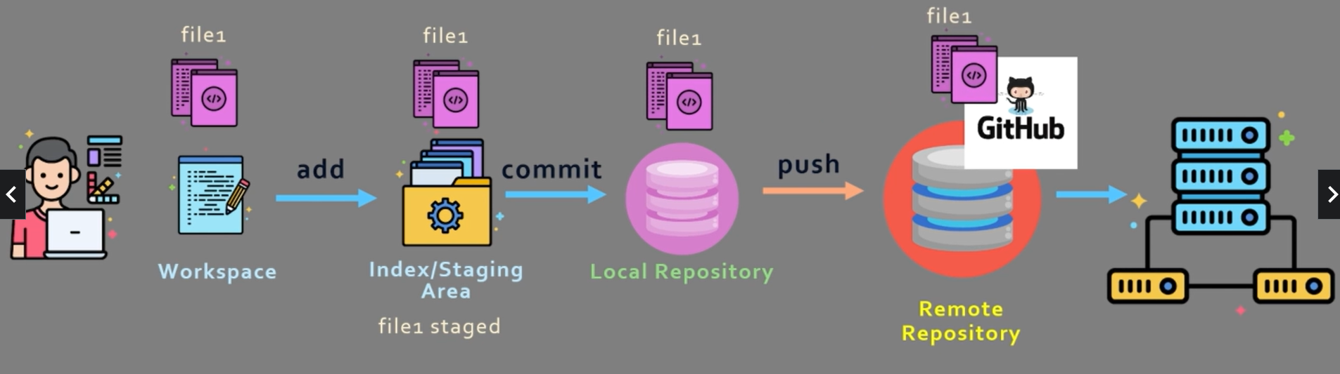
Git Workflow – 5
When user says git push, the changes will go to the remote repository

Slide 21
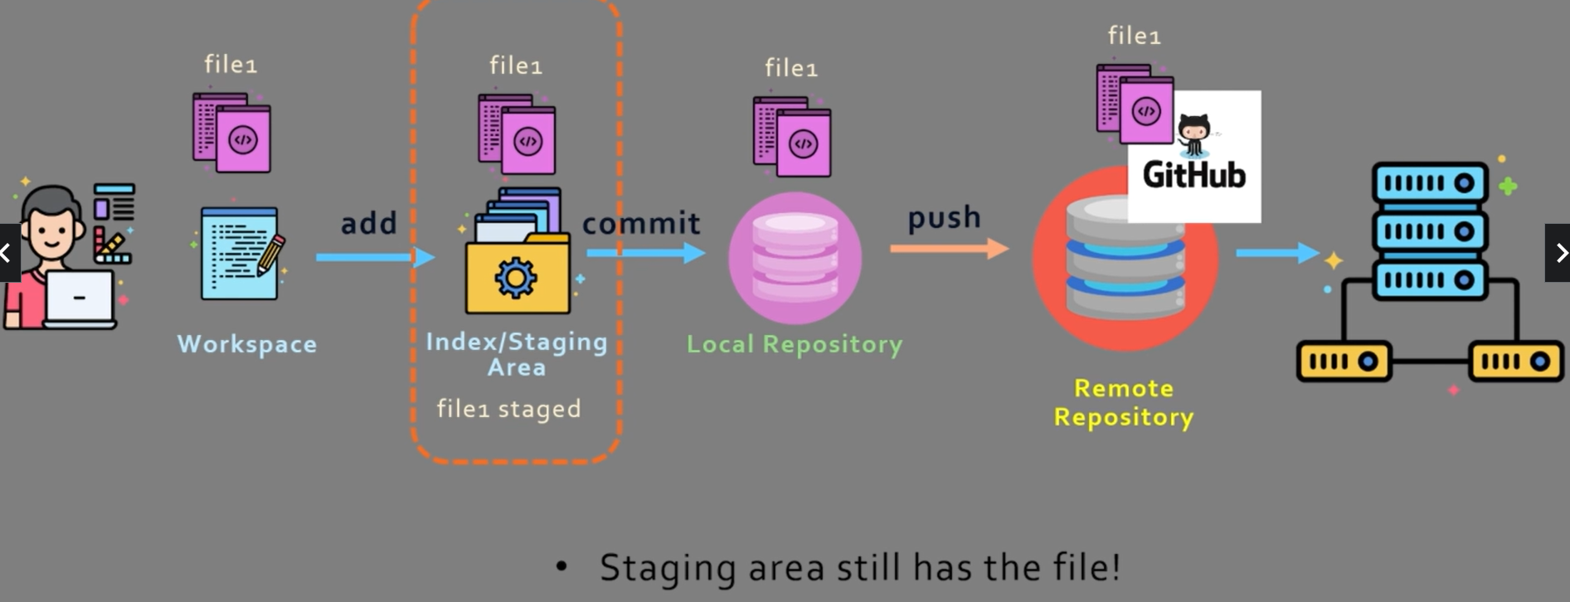
Git Workflow – 6
Important point

Slide 22
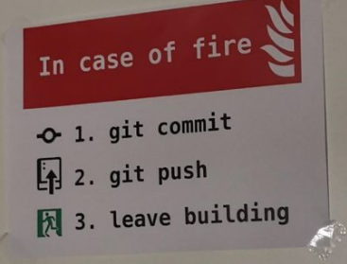
Some Fun!

Slide 23
Git Setup

Slide 24
Download and Setup
Download git and install
git config --global user.name “Atul Kahate”
git config --global user.email test@test.com
Visit github.com and signup using the above email id

Slide 25
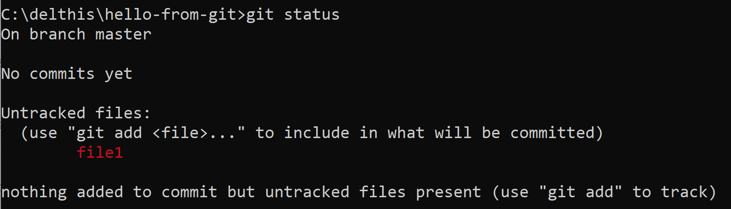
Using git
Create a directory hello-from-git somewhere on the local drive (e.g. C:\delthis\hello-from-git)
To enable tracking of this folder by git, in the folder, run git init
Create file1 in this folder in some text editor (e.g. C:\delthis\hello-from-git\file1)
Type Hello World from Git in the file and save it
On the command prompt, type git status

Slide 26
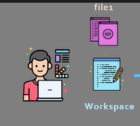
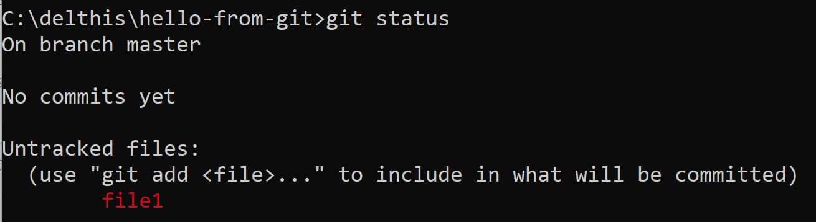
Using git
What does this mean? It means that file1 is in the Workspace

Slide 27
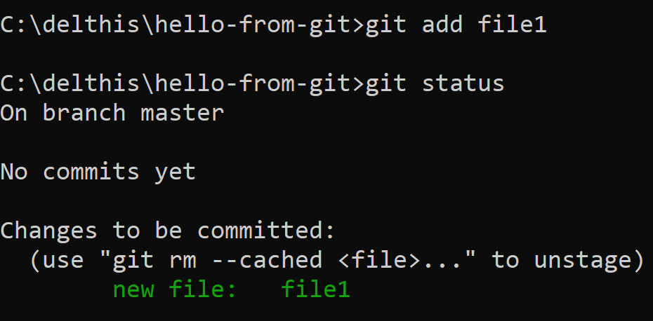
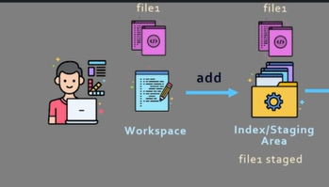
Adding the file to the Index/Staging Area
git add file1

Slide 28
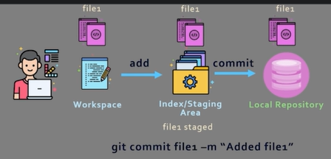
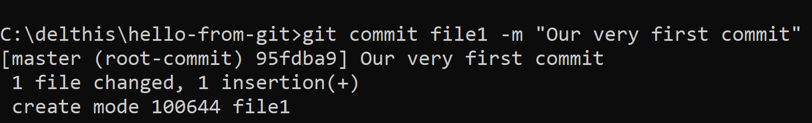
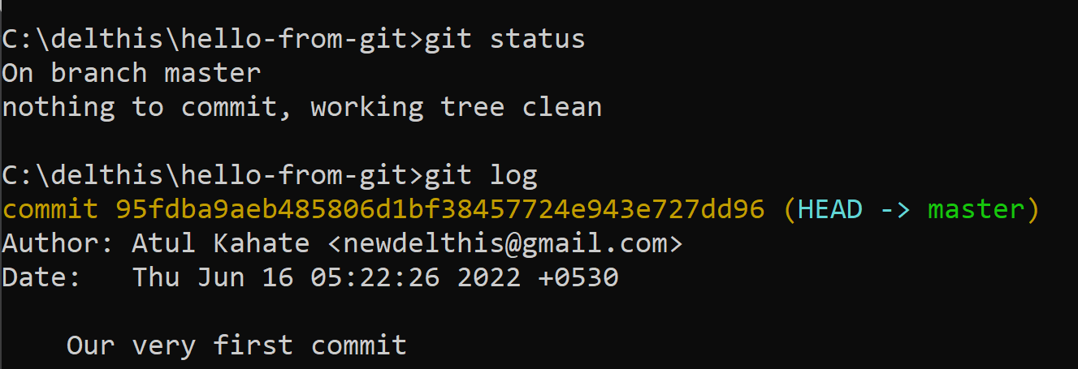
Committing the file to the Local Repository
git commit file1 –m “Our very first commit”
git status and git log

Slide 29
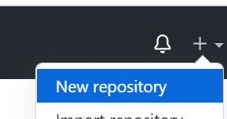

Pushing the file to Github – 1
Go to github and click on New repository
Leave the other defaults and Create repository
Copy the last three commands shown on the next page:
git branch -M main
git remote add origin https://github.com/newdelthis/hello-from-git.git
git push -u origin main

Slide 30
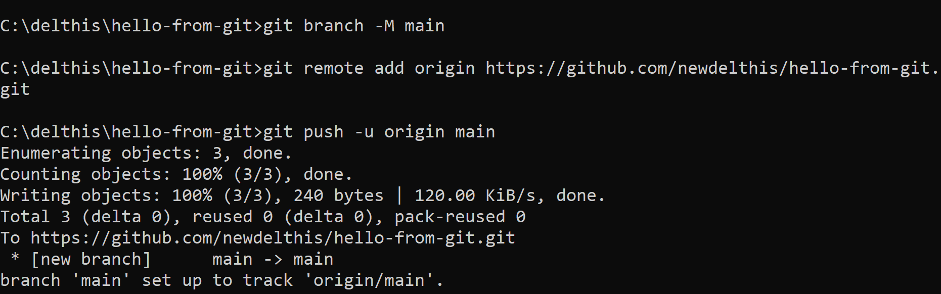
Pushing the file to Github – 2
Paste the three commands on the command prompt and press enter

Slide 31
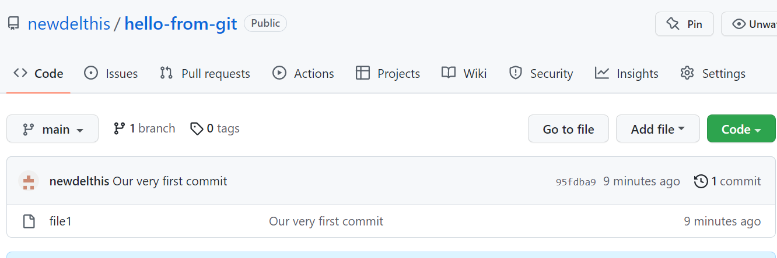
Pushing the file to Github – 3
Verify the repository on the github page by refreshing it

Slide 32
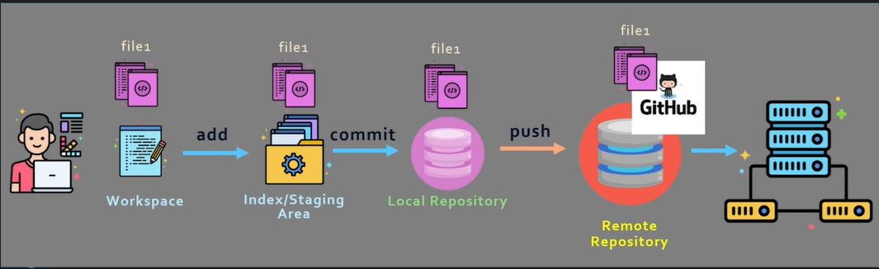
Pushing the file to Github – 4
End result

Slide 33
Comparing files – 1
Let us edit the file in an editor to have these contents (changes in bold):
Hello World, from Git
That was a quick demo
Hope you enjoyed it
Let us see the difference between the local file and file in the staging area by running git diff
See next slide

Slide 34
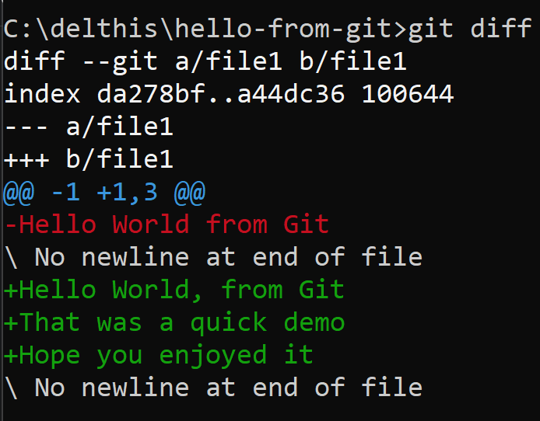
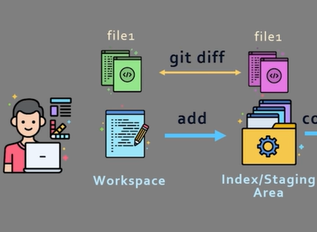
Comparing files – 2

Slide 35
Comparing files – 3: Understanding the results
diff --git a/file1 b/file1
Says that it is comparing the file in two different places
index da278bf..a44dc36 100644
Metadata and indexes
--- a/file1
+++ b/file1
The new and old file, respectively
@@ -1 +1,3 @@
In the old file, changes started from line 1 and ended at line 1
In the new file, changes started at line 1 and ended at line 3

Slide 36
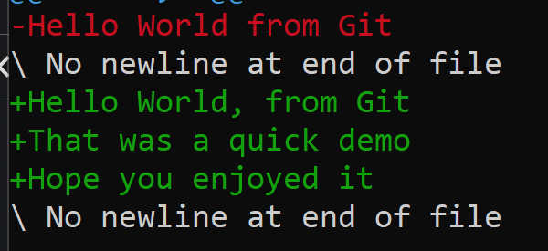
Comparing files – 3: Understanding the results
Deleted lines in red, added lines in green

Slide 37
Again diff, but with a difference
git add .
git diff
Differences between our workspace and staging area

Slide 38
Git Branch and Merge

Slide 39
Branching and Merging – High-level Concept

Slide 40
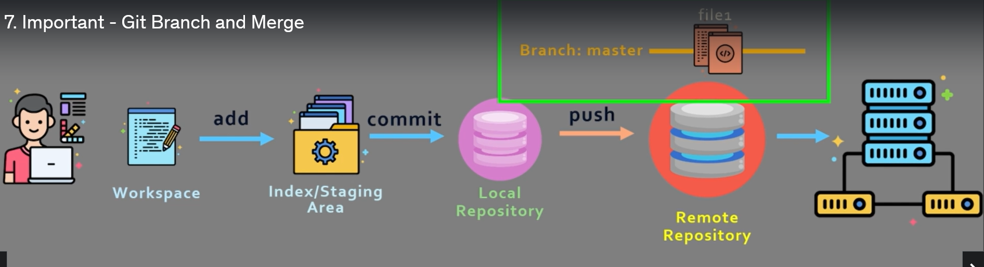
Default Branch
When we push changes to Github, it automatically creates a first branch called as Master

Slide 41
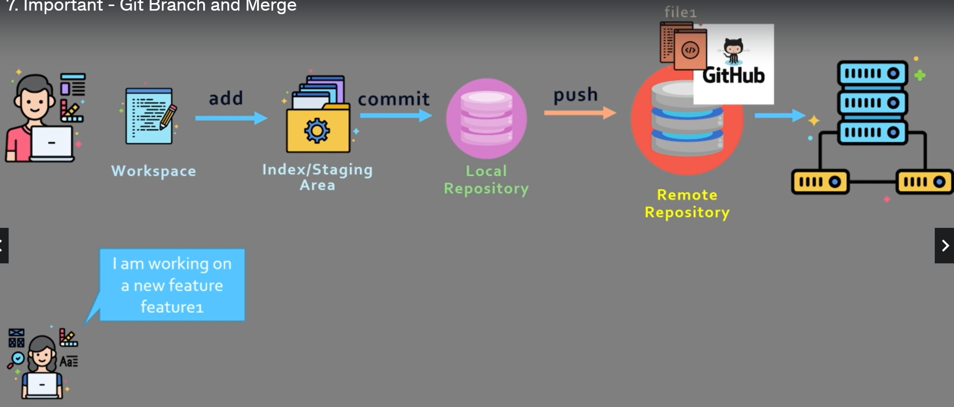
Need for Branch and Merge
Suppose a new developer wants code to add a feature

Slide 42
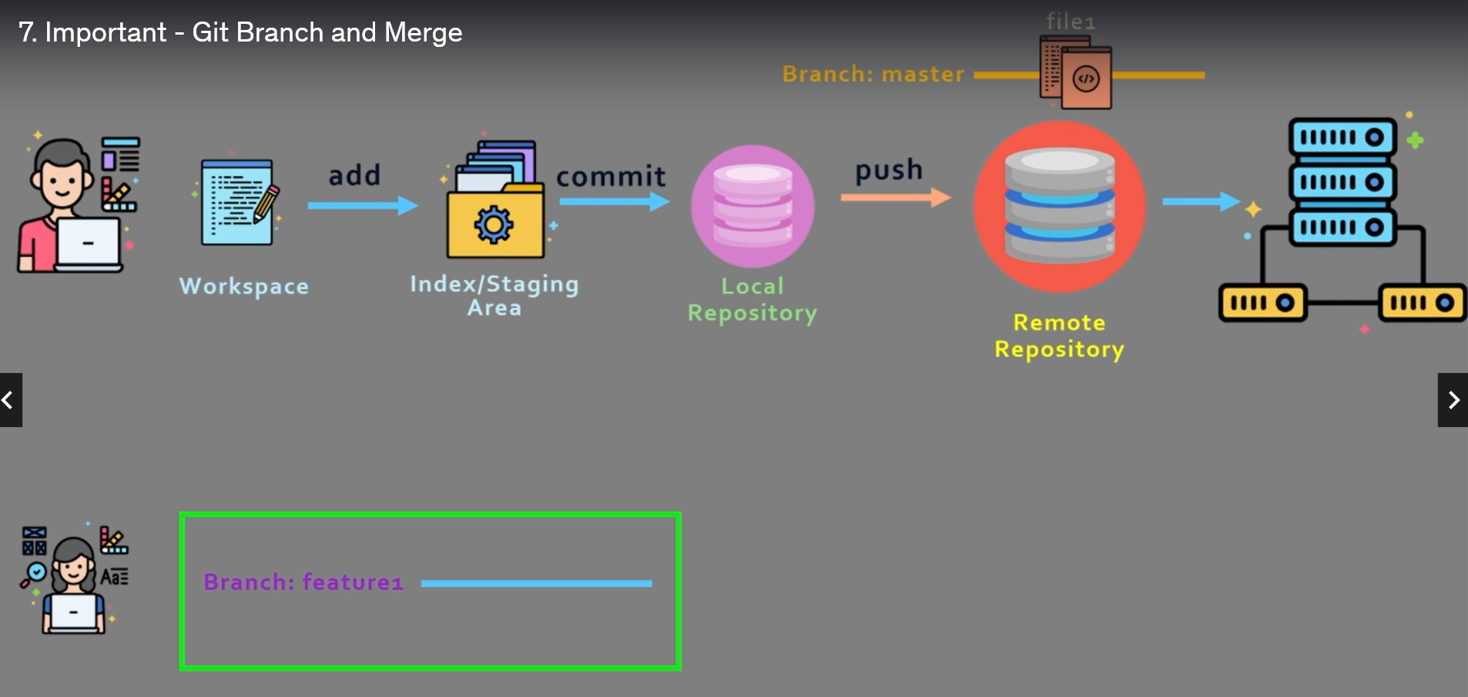
Creating Additional Branches
This developer can create an additional branch for her feature, say called feature1

Slide 43
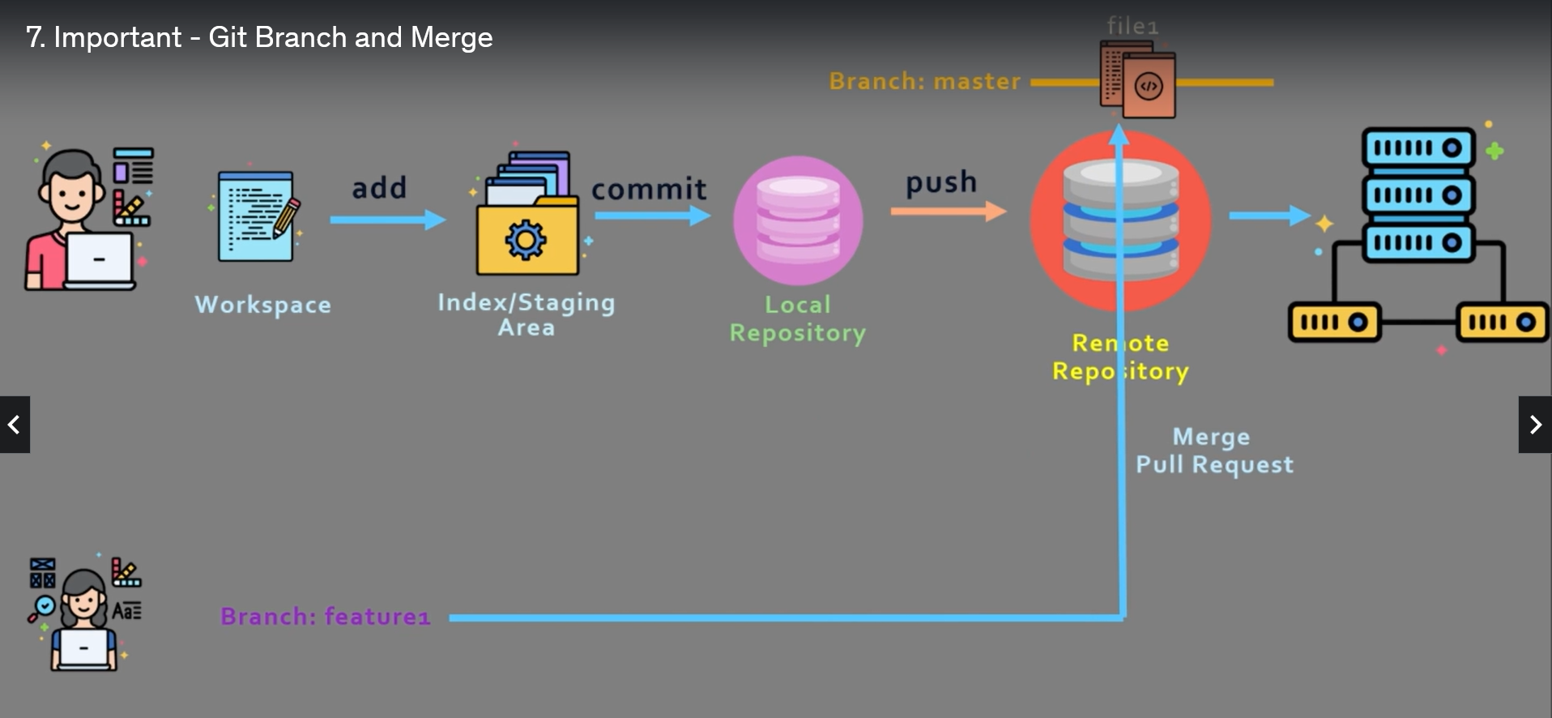
After the Developer completes her work
Someone can review her changes and merge her branch into the master branch

Slide 44
Branching and Merging Step by step

Slide 45
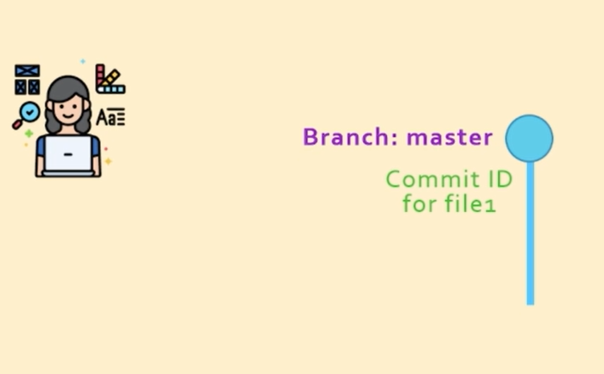
Branching step-by-step
When we create a file locally and commit it, Git automatically creates a branch called Master

Slide 46
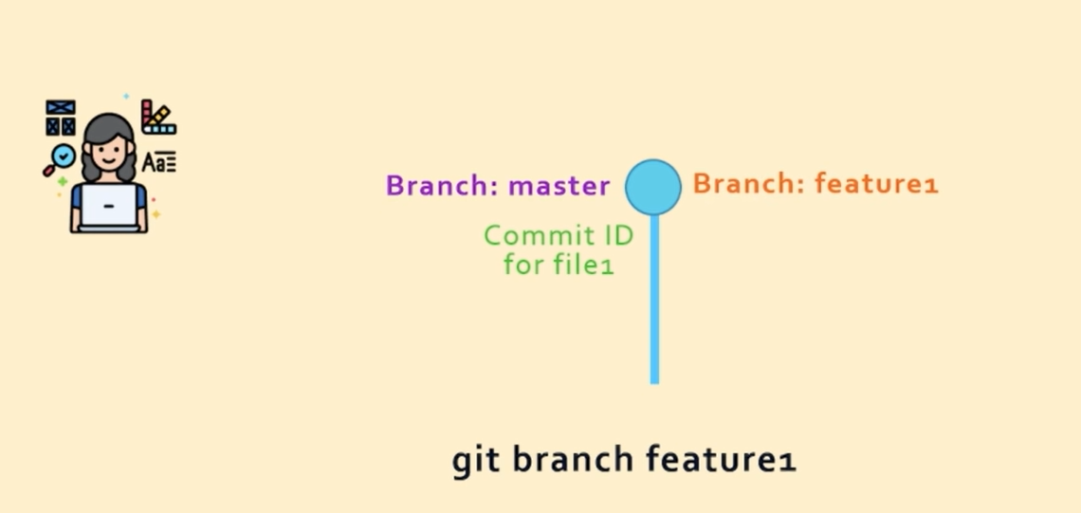
Creating a Branch
To create a branch, we can run a command git branch branch-name, e.g. git branch feature1

Slide 47
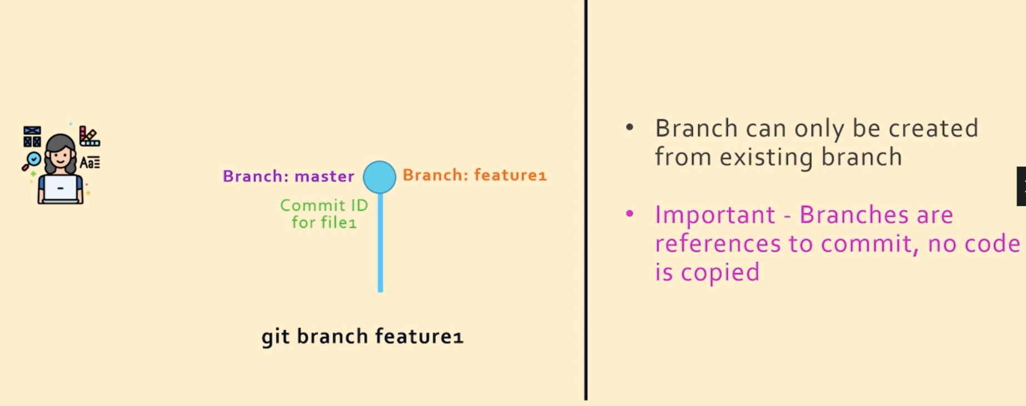
Branching: Key Points

Slide 48

Knowing which Branch we are in
The HEAD pointer

Slide 49

Switching from One Branch to Another
The switch and checkout commands

Slide 50

Result of working with feature1 Branch

Slide 51

Merging the Changes and Contents of feature1 Branch into Master Branch

Slide 52

Result of the previous command

Slide 53

Result of the previous command
Note: This was possible because no changes were made to the master branch

Slide 54

What if we had made changes to the Master branch also? – Confusion!

Slide 55

Recursive Three-way Merge (Two blue, one orange in the figure)

Slide 56

Important!
We need not tell Git to do a fast forward/recursive three way merge – Git automatically does it. Now we can delete branch feature1

Slide 57
Git Branch Demo

Slide 58


Create hello.py (C:\delthis\git-branch-demo-1)

Slide 59

Check the branch
git add helloworld.py
git commit helloworld.py –m “First commit”
git branch

Slide 60


Check the logs
git log --oneline
Current status

Slide 61


Creating a new Branch
Create a new branch feature1: git branch feature1
Check: git branch
Result

Slide 62

Switch the branch to feature1
git switch feature1

Slide 63
Create testpython.text and then add and commit
Change C:\delthis\git-branch-demo-1\helloworld.py:
print ("Hello, world!")
print ("Added this")
C:\delthis\git-branch-demo-1\testpython.txt: this file has some test data to test our code
Let us add and commit these two files (helloworld.py and testpython.txt) in the branch feature1

Slide 64

Committing the files to branch feature1

Slide 65


What is the status? feature1 branch has moved one step ahead of master
git log --oneline

Slide 66

What if we create another branch, say feature2? See next screen
The new branch feature2 will be at the same level of branch feature1
git branch feature2
git log --online

Slide 67

Current status

Slide 68

Let us merge changes of branch1 into master
git switch master
git merge feature1

Slide 69


Updated status
git log --oneline

Slide 70
Rebasing

Slide 71

Regular Merge
Consider that we have two branches master and feature1

Slide 72

Regular Merge
Committing changes from feature1 to master, we use git merge

Slide 73

Regular Merge
Committing changes from feature1 to master, we use git merge

Slide 74

Regular Merge – Problems
If a lot of people are checking in code, this will make the commit history look very messy

Slide 75
Regular Merge – Problems
If a lot of people are checking in code, this will make the commit history look very messy

Slide 76


Solution – Rebase
Instead of creating a new commit id with every merge, simply move the commits at the end of the master branch

Slide 77

Why Rebase?

Slide 78

Rebase Disadvantages
The commit ids from feature1 are not simply moving over the master branch – git creates copies of them, so the original commit ids for feature1 are gone forever

Slide 79


Rebase Demo
C:\delthis>git clone https://github.com/saha-rajdeep/rebase-demo.git
cd rebase-demo and git branch

Slide 80


Rebase Demo
git log --oneline
git branch feature1

Slide 81



Rebase Demo
git switch feature1
type file1
git add .
git commit -m "added line5 from feature1"

Slide 82

Rebasing feature1 branch on top of the main branch
Now switch to main branch
git switch main
Create file3 in the directory C:\delthis\rebase-demo containing a line this is a test
Add this file to the main branch and commit:
git add .
git commit -m "added file3 from main branch"

Slide 83



Rebasing feature1 branch on top of the main branch
git switch feature1
git rebase main

Slide 84


Still need to bring changes from feature1 into main branch
git log --oneline
git switch main
git rebase feature1

Slide 85



Verification
git log --oneline

Slide 86

Squash Merge
Consider that we have a main branch and a feature1 branch (which contains 3 commits)
We can move feature1 branch to the main branch using merge/rebase command

Slide 87



Squash Merge
But what if all the three commits are related to a single change?
Can we merge all the three commits into one?
Squash merge can do that, but only as a part of rebase

Slide 88

Squash Merge Demo
Create a directory squashdemo under c:\delthis
Create a file named file1 in this containing This is in the 'main' branch.
On the command prompt: git init
git branch main
git switch main
git add .
git commit -m “Committed main”

Slide 89

Squash Merge Demo
Now create another file named file2 containing This is in the feature1 branch. and commit in feature1 branch
git branch feature1
git switch feature1
git add .
git commit -m "Commited feature1“
Keep adding something to file2 and repeat add and commit commands above 2-3 times

Slide 90

Squash Merge Demo
git log --oneline

Slide 91


Squash Merge Demo
git rebase -i HEAD~3
It will open a file git-rebase-todo in an editor
Change pick to squash
for the second and third
Save and close the file. It will open another file for comments. Just close it. Result on the next screen.

Slide 92


Squash Merge Demo

Slide 93

Squash Merge Demo
To see all the comments for the commits: git log (But exiting could be a problem!)

Slide 94
Git stash – 1
Stash holds changes saved in a file but not added to Git.
Create a new directory stashdemo in delthis and create three branches feature1, feature2, and feature3.
Remember that you would first need to create at least one file, add it and commit, so that git creates the master branch. Only then you can create other branches.
C:\delthis>mkdir stashdemo
C:\delthis>cd stashdemo
C:\delthis\stashdemo>git init

Slide 95


Git stash – 2
Now create a file file1 containing some text and save it. Then add and commit it. This will create the master branch.
C:\delthis\stashdemo>git add .
C:\delthis\stashdemo>git commit -m "first commit“
Now create the three branches

Slide 96

Git stash
Now edit file1 to add one more line and save it:
This is a test.
This is another test.
Change the branch
C:\delthis\stashdemo>git switch feature3
C:\delthis\stashdemo>git stash save -m "working on file1"

Slide 97
Git stash
Open file1 in the editor. It will contain only the original one line, since the second one is stashed.

Slide 98



Git stash
Now the switch will work
without messages
git stash list
git stash apply 0

Slide 99

Git stash – Verify
Open file1 in the editor: It should have both the lines.
git stash clear
git stash list

